Slide 1
Cloud Computing
Module 5
Platform as a Service (PaaS) and
Software as a Service (SaaS)

Slide 2
Agenda
Platform as a Service (PaaS)
Building blocks of PaaS
Characteristics of PAAS
Windows Azure
Software as a Service (SaaS)

Slide 3
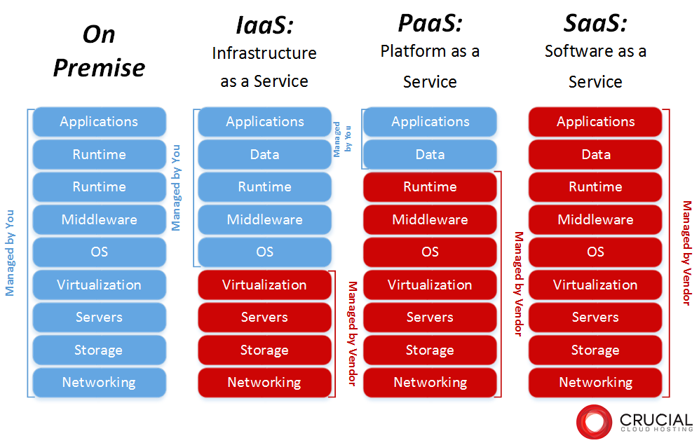
Dependency on IaaS and PaaS
Notes:
RL 4.1

Slide 4
Introduction to PaaS
PaaS is a cloud service where the customer gets a set of application and product development tool hosted on the provider’s infrastructure.
The customer can deploy acquired applications or those created using programming languages and tools supported by the provider.
PaaS services are hosted in the cloud and accessed by users simply via their web browser.
PaaS services can consist of preconfigured features that customers can subscribe to; they can choose to include the features that meet their requirements while discarding those that do not.
The customer (developer) here does not control the underlying cloud infrastructure (Servers, OS, security devices,..) but has a control over the deployed applications and also the configurations of hosting environment.

Slide 5
Introduction to PaaS (Cont…)
PaaS systems usually support the complete life cycle of an application
– Starting from helping in application design
-PAPIs for application development,
-Supporting the build and test environment as well as providing the application deployment infrastructure on cloud.
Additional features during application execution for persistent data usage, state management, session management, versioning and application debugging are also provided by certain PaaS solutions.

Slide 6
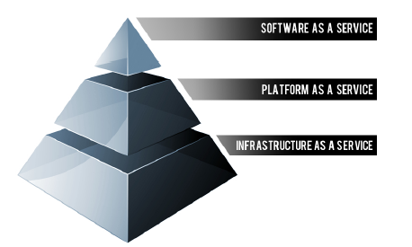
Building blocks of PaaS
Below are some of the features that can be included with a PaaS offering:
Operating system
Server-side scripting environment
Database management system
Server Software
Support
Storage
Network access
Tools for design and development
Hosting

Slide 7
Comparison of In-House Application Development and PaaS
Feature | In-House Application Development | PaaS for Application Development
Multi-Tenancy | Intended for Single or Small group of users | Hundreds to thousands of users, each with multiple active projects. Partition of data is must to protect several users.
User End-Points | Application-based tools, browsers. | Web-browser-based tools
Integrated Development Environment (IDE) | May have several environment and infrastructure for development, test and debugging and production. | Same environment for all phases.
Virtual Machines, Servers, Storage, Databases | Multiple options are available and can be customized to meet any requirement. | Need to work with Infrastructure offered by PaaS providers.
Deployment | Deployment and Scalability are left for installation and go-live phases. | Scalability, failover, and load-balancing are the basic building blocks.
Runtime Monitoring | Development solutions are usually not associated with runtime monitoring. | Built-in monitoring available with the development platform.
Note: PaaS has support of tools to handle billing and subscription management.

Slide 8
Advantages and Risks
Advantages
Users don’t have to invest in physical infrastructure
PaaS allows developers to frequently change or upgrade operating system features. It also helps development teams collaborate on projects.
Makes development possible for ‘non-experts’
Teams in various locations can work together
Security is provided, including data security and backup and recovery.
Adaptability; Features can be changed if circumstances dictate that they should.
Flexibility; customers can have control over the tools that are installed within their platforms and can create a platform that suits their specific requirements. They can ‘pick and choose’ the features they feel are necessary.

Slide 9
Advantages and Risks
Risks
Since users rely on a provider's infrastructure and software, vendor lock-in can be an issue in PaaS environments.
Portability/Interoperability.
Security.
If a provider stops supporting a certain programming language, users may be forced to change their programming language, or the provider itself. Both are difficult and disruptive steps.

Slide 10
Uses of PaaS
PaaS systems can be used to host a variety of cloud services.
PaaS can be used by online portal-based applications like Facebook that need to scale to thousands of users.
Startups who wants to host their new application in a Software-as-a-Service model without any upfront cost for hardware or system software, as well as benefit from the flexibility in scaling to a large number of users.
Enterprise's can deploy their Line-of-Business applications in the cloud, taking advantage of the scale and availability while still maintaining security and privacy of data.
Note: PaaS does not typically replace a business' entire infrastructure. Instead, a business relies on PaaS providers for key services, such as Java development or application hosting.

Slide 11
PaaS Significance through Example Application
Deploying a typical business tool locally might require an IT team to:
- To buy and install hardware, operating systems, middleware (such as databases, Web servers and so on) the actual application.
- To define user access or security.
-To add the application to existing systems management or application performance monitoring (APM) tools.
IT teams must then maintain all of these resources over time.
Paas solution: A PaaS provider supports all the underlying computing and software;– usually through a Web browser interfacusers only need to log in and start using the platform e.
Notes:
RL 4.2

Slide 12
Popular PaaS Providers
Microsoft Azure
Google App Engine
Amazon Web Service (BeanStalk), etc.

Slide 13
Microsoft Azure Platform
Azure can be thought of as a Cloud Operating System over Microsoft blade servers.
This operating system handles provisioning, monitoring and complete management of hardware.
It provides a shared pool of compute, disk and network resources to the applications.
The operating system also manages the application life-cycle on the platform and provides reliable building blocks for authoring applications such as storage, queuing, caching, access control and connectivity services.
Azure is primarily designed for PaaS capabilities, it also includes certain features for Data-as-a-Service (DaaS) and Infrastructure-as-a-Service (IaaS).

Slide 14
Microsoft Azure Platform (Cont…)
Individual applications are run in virtual machines that offer a Windows Server compatible environment and are managed by the cloud operating system.
In addition, the platform offers a relational database (SQL Azure) and a set of services called AppFabric (formerly known as .NET services) that allow on-premise applications to interoperate with applications hosted in the cloud with secure connectivity, messaging, and identity management.

Slide 15
Microsoft Azure Platform
Schematic View of Azure Platfrom Services

Slide 16
Azure Runtime Environment
The hosting environment of Azure is called the Fabric Controller.
It has a pool of individual systems connected on a network and automatically manages resources by load balancing and geo-replication.
It manages the application lifecycle without requiring the hosted apps to explicitly deal with the scalability and availability requirements.
Each physical machine hosts an Azure agent that manages the machine – starting from boot up, installation of the operating system and then the application, application monitoring during its execution, and finally even attempting to fix the system if the agent detects any problems
Windows Azure runtime environment components.

Slide 17
Bird’s-eye view of the internal modules of the platform.
At the heart of the system are the storage and compute clusters – vast numbers of machines kept in Microsoft data centers.
These machines, the operating systems running on them, and applications are managed by the Fabric Controller.
The external interface of the Azure system consists of a set of REST APIs that perform service management and give users access to the storage system.

Slide 18
Fabric Controller Architecture

Slide 19
Fabric Controller
The Fabric Controller (FC) is a distributed program that manages the hardware
and applications in a cluster internally used by Azure.
The key task of the Fabric Controller is to assign the appropriate resources to an application based on the number of roles, number of role instances, and the upgrade and fault domains specified by the application.
Each machine in the cluster runs a hypervisor which hosts virtual machines running Windows compatible OSes.
The host operating system has an Azure host agent that is responsible for monitoring the health of the physical machine, for starting virtual machine instances, and for reporting the health of the machine to the Fabric Controller.
The FC monitors host agents through a heart-beat mechanism; if the FC detects that a host hasn’t responded to a heartbeat within a pre-determined duration, it considers the machine to be down and takes measures to restore the machine.
Guest operating systems have a guest Azure agent that monitors the role running on the VM.

Slide 20
The guest agent restarts roles that terminate and keep the host agent informed about the status of the virtual machine.
The host agent and the guest agent also communicate through a heartbeat; when the host detects that it hasn’t received a heartbeat from a VM, it takes measures to restore the VM.
The FC also brings up new machines into the cluster when required, or when existing machines go down for any reason.

Slide 21
SQL Azure
SQL Azure provides a relational database on the cloud. While Azure Table storage service facilitates storing and querying of structured data, it does not provide full-relational capability provided by a traditional relational database management system (RDBMS).
SQL Azure offers a cloud-based RDBMS system based on SQL Server with nearly all the features offered by on-premise versions of the RDBMS.
Most applications written for SQL Server will work unchanged when the database is deployed on SQL Azure.
SQL Azure also frees customers from the operational details of managing large databases. Instead of focusing on service logs, configuration management, and backup, customers can now focus on what matters to their applications: data.

Slide 22
Azure AppFabric
The Azure AppFabric is a middleware platform that developers can use to bridge existing applications/data to the cloud through secure, authenticated connectivity across network boundaries.
The Azure AppFabric consists of three main components: the Service Bus, Access Control, and Caching modules.

Slide 23
Azure AppFabric (Cont….)
The Service Bus provides secure messaging and connectivity between cloud and on-premise applications and data. It exposes on-premise data and services in a secure manner to selected cloud applications through firewalls, NAT gateways and other restrictive network boundaries.
The Access Control component provides users across the organizations a single sign-on facility to access services hosted on Azure. Access Control allows an organization to selectively expose its data and services to partners, vendors, and customers in a secure manner, with appropriate authorization at the access points.
Caching component provides an in-memory, scalable, highly available cache for application data, which includes data stored in Azure tables and SQL Azure. Caching improves the performance of both cloud applications and on-premise applications that access cloud resources through intelligent caching of managed objects.

Slide 24
Azure Programming Model
The applications in Azure use the programming model of a Web role and a Worker role and applications are required to be configured on Windows Azure with the number of instances of each role that should be created.
The Web role enables web applications to be hosted on IIS servers and provides external interactivity while the Worker role mirrors the heavy-duty processing that is typically done by Windows services and applications.
Web roles can be implemented using any technology supported by Microsoft’s web-server Internet Information Services (IIS) 7, which includes plain HTML/JS, ASP.NET, and Windows Communication Framework (WCF).
Notes: Windows Azure provides in-built load-balancing to spread requests across Web-role instances of a single application.
Web roles and Worker roles communicate by either using message queues.

Slide 25
Compute service with two Web roles and two Worker roles
Compute service with two Web roles and two Worker roles.

Slide 26
Azure Cloud Storage Services
Blob service: For large binary and text data, especially unstructured objects like images and media.
Table Service: For structured storage of non-relational data.
Queue Service: For message passing between components.
Azure Drives: To use as mounted file systems.

Slide 27
BLOB
The Blob service lets applications store and retrieve large binary and text data, called blobs (Binary Large Objects). It provides file-level storage and is similar to Amazon S3.
Blobs are (typically large) unstructured objects like images and media.
It also allows developers to mount blobs as “cloud drives” for programmatic access from within the applications. Windows Azure Drives are used for mounting an NTFS volume to be accessed by an application, and are similar to Amazon EBS.
Applications deal with blobs as a whole, although they might read/write parts of a blob. Blobs can have optional metadata associated with them in the form of key-value pairs; for instance, an image could have a copyright notice stored as metadata.

Slide 28
BLOB (Cont…)
Blobs are always stored under containers, which are similar to buckets in Amazon’s S3.
Every storage account must have at least one container, and containers can have blobs within them. Container names can contain the directory separator character (“/”) – this gives developers the facility to create hierarchical “file-systems” similar to those on disks.
The blob service defines two kinds of blobs to store text and binary data:A page blob and a block blob.
-Page blobs are blobs that are optimized for random read/write operations anywhere in the content of the blob.
-Block blobs are optimized for streaming and are read and written a block at a time.
Note: access to blob and storage services in Azure is through REST interfaces

Slide 29
Table Service
The Table service is used for structured storage for non-relational data, and is similar to Amazon’s SimpleDB.
For structured forms of storage, Windows Azure provides structured key-value pairs stored in entities known as Tables.
The Table storage uses a NoSQL model based on keyvalue pairs for querying structured data that is not in a typical database.
Table is a bag of typed properties that represents an entity in the application domain.
For instance, the definition {EmployeeId: int, EmployeeName: string} defines a table that could be used to store (minimal) employee data.
Data stored in Azure tables is partitioned horizontally and distributed across storage nodes for optimized access.
Every table has a property called the Partition Key, which defines how data in the table is partitioned across storage nodes – rows that have the same partition key are stored in a partition.
In addition, tables can also define Row Keys which are unique within a partition and optimize access to a row within a partition. When present, the pair {partition key, row key} uniquely identifies a row in a table.

Slide 30
Queue Service
Queues are the third kind of storage, provided for reliable message delivery within and between services.
A storage account can have unlimited number of queues, and each queue can store an unlimited number of messages, with the restriction that messages are limited to 8KB (for example).
Queues are used by Web roles and Worker roles for inter-application communication, and by applications to communicate with each other.

Slide 31
Scalability in Azure
Note: Each queue offers a throughput of nearly
500 transactions per second. For higher throughput, developers can create multiple
queues between Web roles and Worker roles, and have the Worker roles pick up
messages either at random, or based on some other scheduling strategy
Scaling Web and Worker roles using shared queues.

Slide 32
Example Application “Hello World” using Azure
Objective: To develop a Web application that displays a custom homepage, accepts the visitor’s name, and welcomes him/her.
Important Notes:
Windows Azure applications typically have multiple instances running on different virtual machines. However, developers need not create nor manage these virtual machines explicitly.
Developers just write applications either as a Web role and/or Worker role, and tell
Windows Azure the number of instances of each role that should be created.
Windows Azure silently creates the requisite number of virtual machines, and hosts instances of the roles on them.
Development tools:
Download (Windows Azure SDK and Visual Studio) and install development tools required to develop Azure applications.

Slide 34
Web Role and Worker Role for “Hello World”
A Visual Studio Solution is a collection of related projects grouped as logical entities.
The Web role is essentially an ASP.NET web application, with additional features for cloud-based deployment.
The Worker role is a simple C# program. Programming languages such as Python and PhP also could be used to implement worker role.
Modify the “Default.aspx” page to add a custom message, It is possible to build the solution to create a simple Azure application which consists of two files – a service package (*.cspkg) that contains the binaries, and a service configuration (*.cscfg) that is used to configure the application.

Slide 35
Message Passing between web role and worker role
How messages can be passed from one component to another?
-For this example, the Web role will prompt the user for his/her name and pass that to the Worker role and print back the result got from the Web role.
- For this, the handler OnSubmitBtnClick for the “Submit” button needs to pass the input string as a message to the Worker role.
- To enable this communication between the Web role and Worker role, it is necessary to use the message-passing features of Azure.

Slide 36
Message passing through queues
To use the message-passing APIs, it is necessary to create a storage account object, and that is specified in the configuration file with the key AzureStorageConnectionString.
2. It is then necessary to get a reference to the queue to transmit messages to the worker. This is needed for the two-way communication between the Worker role and Web role introduced for this example.
- For this, two queues are used, the first one named webtoworker and the second named workertoweb. This is accomplished by the GetQueueReference method, which returns a reference to the queue.
Note: The name of the queue
//must be the same at both the web role and the worker role.
3. It is now possible to add a message to the queue for the Worker role – simply send the string typed by the user as the message to the Worker role. This message is added to the webtoworker queue. //Wait for a response from the worker
4. The sent message will now reach the Worker role. To process the response from the worker, it is necessary to listen to the messages on the workertoweb queue.

Slide 37
Message passing through queues (Cont…)
5. Once the message is retrieved, delete the message from the queue, so that the same message is not processed twice, and show the reply to the user by setting the ResultLabel field to the text returned by the Worker role.
Note1: The Worker role has to monitor the incoming message queue for new messages, and when it gets a message, it has to respond back with a message, say, the server time.
Note2: a ConfigurationSettingPublisher must be set for both the Web role and Worker role so that the correct configuration files are read.

Slide 38
Azure Test and Deployment
Visual Studio must be started in administrator mode to debug cloud applications.
The application would be now running on the local machine on top of a Windows Azure emulator known as the development fabric.
The development fabric provides the functionality of Windows Azure on the local machine so that users can debug the logic of their services in the familiar environment provided by Visual Studio.
Deploying Azure applications:
-one needs to obtain an Azure subscription from the Microsoft Online Customer Portal.
- Once a subscription is created, a developer login is available to the Windows Azure developer portal at http://windows.azure.com, where the developer can create a new project.
- Once a subscription has been obtained in the developer portal, the next step is to create a hosted service and a storage account for the new application.
- The hosted service creates the end points for accessing the application. The unique service
URL that is selected here will be used by clients to access the application.
- Similarly, the storage account exposes the endpoints for accessing cloud storage for the application.

Slide 39
Deployment environments
-Two deployment environments – production and staging.
Both environments host the application on the cloud, but the staging environment creates the deployment with a temporary URL as the end point, while the production deployment uses the service URL.
Applications can be moved from production to staging and vice-versa at any time.
The staging application is hosted on a temporary URL, one that is nearly impossible to discover accidentally. This allows developers to deploy their applications on the cloud and test them before making them publicly available.
Finally, the deployment switch icon is selected to move the service into production.
The application would be now available on, e.g., http://simpleazureservicecc.cloudapp.net.
Note: If more instances of the Web or the Worker role are needed, the service configuration from the configuration page in the portal can be modified.

Slide 40
Summary of Deploying Applications on Azure
In general, the following are the steps needed to build an Azure application.
First the Web and Worker roles for the new application were created and tested in the development environment.
Then an Azure subscription needs to be obtained and use it to create a hosted service and storage account.
Next, the application would be tested in the development environment but using cloud storage.
Further testing on the cloud, but in a staging environment.
In the end, the staging environment was switched to production making the application globally accessible at the desired URL.

Slide 41
Billing on Azure
CPU Time Billing
Windows Azure starts billing for CPU time when applications are deployed in the staging
environment and continues billing when applications (either in staging or production) are
suspended. Applications must be deleted from the portal for billing to stop.

Slide 42
Google App Engine
Google App Engine (GAE) is an example of a Platform as a Service (PaaS) that enables users to develop and host their own applications.
It enables us to run web applications on Google Infrastructure.
Application on GAE are easy to build, maintain and scale as the traffic and storage needs grow.
It also provides distributed storage with replication and load balancing of client requests.

Slide 43
Features of Google AppEngine
Feature | Description
Popular Languages | Node.js, Java, Ruby, C#, Go, Python and PHP
Fully managed | Focus on Code while App Engine manages infrastructure concerns
Powerful application diagnostics | To monitor the health and performance of our app and diagnose and fix bugs errors easily
Application versioning | Different versions of app can be hosted and easily create development, test, staging, and production environments
Application security | Help safeguard our application by defining access rules with AppEngine firewall and leverage managed SSL/TLS certificates by default at no addition cost
Services ecosystem | Tap a growing ecosystem of Google Cloud services from our app including excellent suit of cloud developer tools

Slide 44
Types of Scaling
Basic
Creates instances when your application receives requests.
Each instance will be shut down when the application becomes idle.
Automatic Scaling
Creates instance based on request rate, response latencies, or other application metrics that you specify.
Manual Scaling
Allows you to manually specify the number of instances that continuously run regardless of the load level.

Slide 45
App Engine Security
Applications run in a secure environment that provides limited access to the underlying operating system
Sandbox isolates the application that is independent of hardware, operating system and physical location of a web server.
Sandbox restricts what our application can do
Limitations imposed by sandbox (for security):
- An application can only access other computers over internet using the provided URL fetch and email services.
- Applications cannot write to local file system.
Application code runs only in response to a web request, a queued task or a scheduled task and must return
the response data within 60 seconds.
- A request handler cannot spawn a subprocess or execute code after the response has been sent.

Slide 46
Benefits of App Engine for WebSites
Availability
Faster Launch Time
Easy to use
Diverse set of APIs (Searching, Application log files, Cloud storage, SSL support, URL Fetch, Mail, etc.)
Scalability
Smart Pricing model

Slide 47
Persistent Storage
Using persistent stores in Google App Engine.

Slide 48
Persistent Storage (Cont…)
An App running within the sandbox environment of Google App Engine cannot write to the file system and has other restrictions on using OS calls.
However, in reality, two apps may want to communicate or two components may want to share data or two requests may fall under a single session of the application and hence need persistent data.
In order to use such persistent data across requests, the application must use special App Engine services such as datastore, and memcache.

Slide 49
Datastore
The datastore service provides a distributed data storage with a query engine that supports transaction semantics.
The datastore is a key-value storage (similar to Amazon SimpleDB)
Every data record is an entity and is identified using a key and a set of properties. Operations on groups of entities can also be performed if a transaction requires it.
The App Engine datastore provides high availability by replicating the data in multiple copies and providing a well-proven algorithm (called Paxos algorithm) to synchronize the multiple copies and provide eventually consistent responses

Slide 50
memcache
The memcache service can be used to speed up the datastore queries by having a local cache.
For example, if a book is newly published and has become a hot seller, instead of going to the datastore for updating the sales data, the developer may wish to keep that entity information in cache, update it locally and write back to datastore later.
Similarly, when multiple clients are requesting the same, it helps to serve the response from the cache instead of a datastore.

Slide 51
App Engine SDK (Software Development Kit)
The App Engine SDK allows us to run Google App Engine applications on our local computer. It simulates the run-time environment of the google app engine infrastructure.
A separate SDK needs to be downloaded and installed as per the programming language.
The SDK can be used for developing, deploying and managing applications.
The SDK comes with a local web server for test deployment. We can then deploy the developed application onto the Google App Engine.
This local web server simulates the secure runtime or App Engine sandbox environment with limited access to the underlying operating system.
For example, the application can only be accessed using HTTP on specific ports. It cannot write to the file system and can read only files that were uploaded along with application code.

Slide 52
Developing a Web Application using Flask Framwork
Directory Structure
Application-Folder
Installations required:
Python 3
Flask
SDK
main.py
templates
Home.html
Page1.html, etc.
static
css
template.css

Slide 53
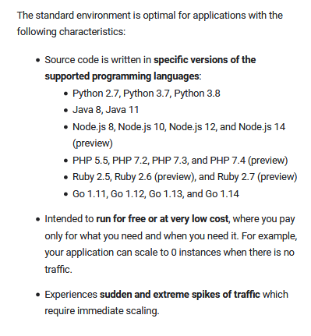
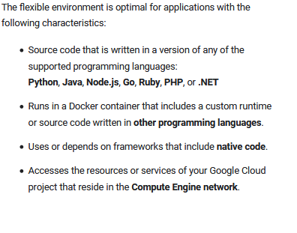
Choosing an App Engine environment
We can run your applications in App Engine using the flexible environment (Application instances run within a Docker container) or standard environment (Application instances run within a sandbox) .
We can also choose to simultaneously use both environments for your application and allow your services to take advantage of each environment's individual benefits.
Ref: https://cloud.google.com/appengine/docs/the-appengine-environments

Slide 54
Demonstration of a Simple Hello World Application (Python based) using Google AppEngine
Create a project: Projects bundle code, VMs, and other resources together for easier development and monitoring.
Build and run your "Hello World!" app: Develop and deploy the app to the web using the gcloud command.
URL: https://cloud.google.com/community/tutorials/python-gae-quickstart

Slide 55
Demonstration of a Simple Hello World Application using Google AppEngine (Cont…)
Log into the Google Cloud Platform (GCP) account.
Select AppEngine on Google Cloud Platform
Click CreateApplication, select the Region (e.g., US Central)
Then, click Create app and wait for a while, application environment would be created.

Slide 56
Demonstration of a Simple Hello World Application using Google AppEngine (Cont…)
Project Setup:
Google Cloud organizes resources into projects, which collect all of the related resources for a single application in one place. For Project Details: (https://cloud.google.com/resource-manager/docs/creating-managing-projects#creating_a_project)
Using Cloud Shell: Cloud Shell is a built-in command-line tool for the console. We will use Cloud Shell to deploy our hello world app.
Open Cloud Shell: Open Cloud Shell by clicking the view gcloud command button in the navigation bar in the upper-right corner of the console on Google Cloud Instance and then select Run in Cloud Shell.
2. Clone the sample code:
Use Cloud Shell to clone and navigate to the "Hello World" code. The sample code is cloned from your project repository to the Cloud Shell.
Note: If the directory already exists, remove the previous files before cloning.
In Cloud Shell, enter the following:
git clone https://github.com/GoogleCloudPlatform/python-docs-samples

Slide 57
Demonstration of a Simple Hello World Application using Google AppEngine (Cont…)
3. Then, switch to the hello world directory:
cd python-docs-samples/appengine/standard_python3/hello_world
4. Configuring our deployment
We are now in the main directory for the sample code. It contains the following files:
app.yaml (this file contains the minimal amount of configuration required for a Python 3 application. The runtime field specifies the python37 run-time environment.)
main.py
main_test.py
requirements-test.txt
requirements.txt (list of software's to be installed)
We can check the content of each of the above files on cloud shell, e.g., cat app.yaml
Notes: - The application is a simple Python application that uses the Flask web framework. This Python app responds to a request with an HTTP header and the message Hello World!.
- App Engine uses YAML files to specify a deployment's configuration. app.yaml files contain information about our application, like the runtime environment, environment variables, and more.

Slide 58
The runtime field specifies the python37 run-time environment.
Demonstration of a Simple Hello World Application using Google AppEngine (Cont…)
Testing our app
Cloud Shell lets us test our app before deploying to make sure it's running as intended, just like debugging on our local machine.
- To test your app, first create an isolated virtual environment. This ensures that your app does not interfere with other Python applications that may be available on your system.
virtualenv --python python3 ~/envs/hello_world
- Activate your newly created virtual environment:
source ~/envs/hello_world/bin/activate
- Use pip to install project dependencies. This "Hello World" app depends on the Flask microframework:
pip install -r requirements.txt
- Finally, run your app in Cloud Shell using the Flask development server:
python main.py

Slide 59
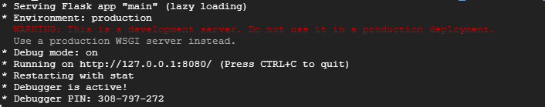
Demonstration of a Simple Hello World Application using Google AppEngine (Cont…)
Note1: We can Preview our app with "Web preview“ button available on the right corner of the cloud shell window and then select Preview on Port 8080.
Note2:Terminate the instance of the application by pressing Ctrl+C in the Cloud Shell.

Slide 60
Demonstration of a Simple Hello World Application using Google AppEngine (Cont…)
6. Deploying to App Engine
gcloud app deploy
If you face some issue due to the already existing applications, then follow the below:
gcloud projects list (it will show all the projects available, i.e., Project_Id, Name and Project_Number)
Then we may set it for your current workspace by running:
gcloud config set project VALUE (Project_Id has be specified in place of VALUE.) and
then type gcloud app deploy
It will return the URL after successful deployment. This URL can be used to access the deployed application.
Note: The default URL of your app is a subdomain on appspot.com that starts with your project's ID: .appspot.com.

Slide 61
Demonstration of a Simple Hello World Application using Google AppEngine (Cont…)
7. Disable your project
-Go to the Settings page of App Engine.
-Click Disable Application.
.

Slide 62
Creating New Project
Go to cloud console
Create a new project using the below command:
gcloud projects create PROJECT_ID
Where PROJECT_ID is the ID for the project you want to create. A project ID must start with a lowercase letter, and can contain only ASCII letters, digits, and hyphens, and must be between 6 and 30 characters.

Slide 63
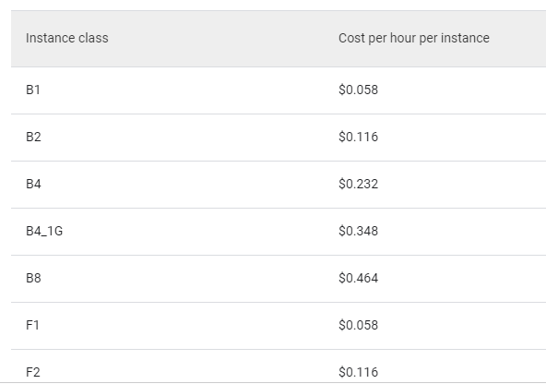
Pricing
AppEngine has a pricing model that scales with your app’s usage.
Pricing is different for apps in the standard and flexible environments.
Standard environment:
- Apps in the standard environment have a free tier for App Engine resources.
Accrual of instance hours begins when an instance
starts and ends as described below, depending on the
type of scaling we specify for the instance:
Basic or automatic scaling: accrual ends fifteen
minutes after an instance finishes processing its last
request.
- Manual scaling: accrual ends fifteen minutes after an instance shuts down.

Slide 64
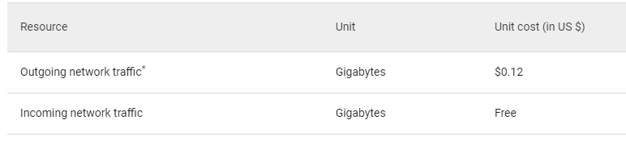
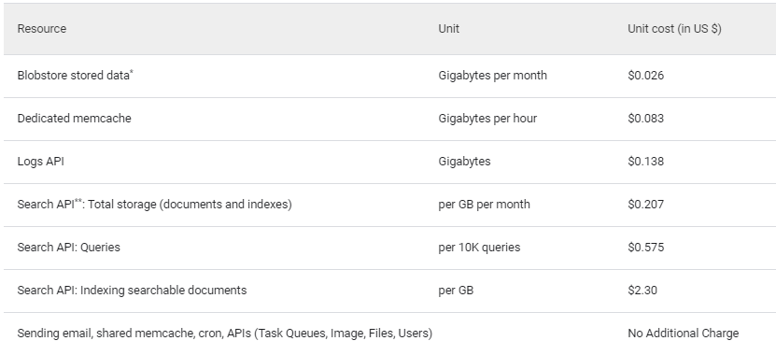
Pricing (Cont…)
Network resources:
Legacy App Engine resources:
Flexible environment price details: https://cloud.google.com/appengine/pricing

Slide 65
Reference for Python Web Application
https://www.freecodecamp.org/news/how-to-build-a-web-application-using-flask-and-deploy-it-to-the-cloud-3551c985e492/

Slide 66
SaaS (Software As A Service)
The agenda of SaaS:
What is SaaS?
Traditional Model
How is it delivered?
SaaS Architecture
Advantages of SaaS
User and Vendor benefits of SaaS
2

Slide 67
Software As A Service (SaaS)
IaaS: It delivers computing resources as a service.
PaaS: Application deployment platforms can be delivered as a service. These are generic services that can be used by developers for creating new applications
SaaS: It delivers application software as a service.

Slide 68
Dependency on IaaS and PaaS
Notes:
RL 5.1

Slide 69
Problems in traditional Model
In the traditional model of software delivery, the customer acquires a perpetual license and assumes responsibility for managing the software.
There is a high upfront cost associated with the purchase of the license, as well as the burden of implementation and ongoing maintenance.
ROI is often delayed considerably, and, due to the rapid pace of technological change, expensive software solutions can quickly become obsolete.

Slide 70

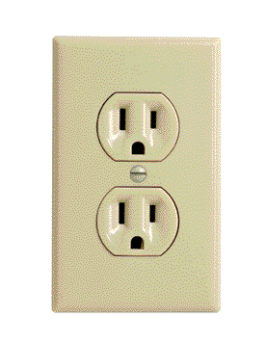
Problems in traditional Model
Traditional Software
On-Demand Utility
Plug In, Subscribe Pay-per-Use
Build Your Own

Slide 71
What is SaaS?
It is a complete cloud computing service model in which the computing hardware and software, as well as the solution itself, are provided by a vendor as a complete service offering. It is referred to as the Software as a Service (SaaS) model.
SaaS can be described as software that is deployed on a hosted service and can be accessed globally over the Internet, most often in a browser.
Every computer user is familiar with SaaS systems, which are either replacements or substitutes for locally installed software.
Examples of SaaS software for end-users are Google Docs, Gmail and Calendar, YouTube, etc.

Slide 72
SaaS cloud Model

Slide 73
SaaS Characteristics
The software is available over the Internet globally through a browser on demand.
2. The typical license is subscription-based or usage-based and is billed on a recurring basis. In a small number of cases a flat fee may be changed, often coupled with a maintenance fee.
3. The software and the service are monitored and maintained by the vendor, regardless of where all the different software components are running.
There may be executable client-side code, but the user isn’t responsible for maintaining that code or its interaction with the service.
4. Reduced distribution and maintenance costs and minimal end-user system costs generally make SaaS applications cheaper to use than their shrink-wrapped versions.

Slide 74
SaaS Characteristics (Cont…)
5. Automated upgrades, updates, and patch management and much faster rollout of changes.
6. SaaS applications often have a much lower barrier to entry than their locally installed competitors, a known recurring cost, and they scale on demand (a property of cloud computing in general).
7. All users have the same version of the software so each user’s software is compatible with another’s.
8. SaaS supports multiple users and provides a shared data model through a single-instance, multi-tenancy model.

Slide 75
SaaS – How is it delivered
The SaaS based software is delivered to the users with the help of internet.
Traditional desktop applications such as word processing and spreadsheet can now be accessed as a service in the Web.
This model of delivering applications, alleviates the burden of software maintenance for customers and simplifies development and testing for providers.

Slide 76
Customization Support for SaaS
Some SaaS solutions expose Application Programming Interfaces (API) to developers to allow them to create custom composite applications.
These APIs may alter the security model used, the data schema, workflow characteristics, and other fundamental features of the service’s expression as experienced by the user.
Examples of an SaaS platform with an exposed API are Salesforce.com and Quicken.com.

Slide 77
SaaS Application Architecture
Scaling the application:
- Maximizing concurrency, and using application resources more efficiently, i.e. optimizing locking duration, sharing pooled resources such as threads and network connections, caching reference data, and partitioning large databases.

Slide 78
SaaS Application Architecture (Cont…)
Multi-tenancy :
One application instance must be able to accommodate users from multiple other companies at the same time
All transparent to any of the users.
This requires an architecture that maximizes the sharing of resources across tenants and yet should be able to differentiate data belonging to different customers.

Slide 79
SaaS Application Architecture
Configurable:
To customize the application for one customer will change the application for other customers as well.
Traditionally customizing an application would mean code changes
Each customer uses metadata to configure the way the application appears and behaves for its users.
Customers configuring applications must be simple and easy without incurring extra development or operation costs

Slide 80
Advantages of SaaS for Users
Users can directly use these applications without any new software installations on their local machines, as these applications will now execute within a web browser (YouTube, for example).
The required software will be available on multiple platforms and can be used from any of the user’s devices (say, home PC, office PC, mobile device).
If the application is needed only for a short period of time, the user
can simply pay per use.
Applications can be customized for different users both in terms of user interface and selected features, so there is no loss in flexibility.

Slide 81
Advantages of SaaS from Vendors’ Point of View
Many service providers can economically offer a new application as a service directly instead of creating packages and distribution channels.
It helps to ensure that the software is not pirated.
The vendors need not worry about distributing updates of newer versions of the application; only the cloud application needs to be changed and the new version will now be used the next time the consumer accesses it.

